Slide 1
Car Charging Simulation Team 17
1. Ahmed Hobeishy (7219053, MDT)
2. Varsha Vijayan (7216653 ,MDT)
3. Silpa Prasad Sivaprasad (7216655 ,MDT)

Slide 2
Agenda
Running the Application
Tests
Class Diagram
ChargingStation and Cars
Car Charging Simulation Logic
Car Queueing and Station Entry Logic
Metadata Loading
Communication Inside the App
Logging System
Search Functionality
Multi-User Access

Slide 3
Responsibilities
Ahmed Hobeishy:
Create multi-user access to the charging station external users who could book timeslot and be part of the prioritized queue, administrators
Use byte and character streams for simulation of the data exchange in the system
Simulate multithread charging of the reserved batteries from several energy sources + test the entire application.
chain exceptions + rethrow exception: catch the exception then put it into a more meaningful exception and re-throw it Test the cars and stations packages
a base Logger that get the date of today and choose the folder and file to log to based on it
log generator that generates test logs for the last x days, so we can see how logs will look like after days of running the system
Silpa Prasad Sivaprasad:
Handling multiple exception: in the chargingLocation class the OccupiedException is handle then any other ChargingException is handles then any other exceptions are handled.
Create metadata for your project
Simulate the system which allow to charge simultaneously 1..N vehicles, depending on the available resources.
search utility that uses Regular expressions to search for the log file based on the name of the equipment or date
Test cases for the the energy package
Varsha Vijayan:
Resource Management: use try-with-resources to manage the filteWriter in the baseLoger class
managing the log files
Logic on the scenario when car arriving in random moment of time. When the car appear in the queue should be calculated the waiting time, if time is more then 15 min car leaving the queue.
Command line interface that uses the search utility to search for the log file and open it in the default text editor
test cases for the logging package

Slide 4
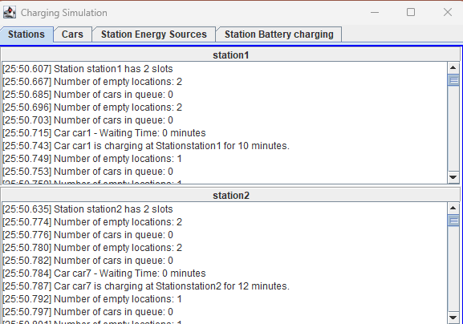
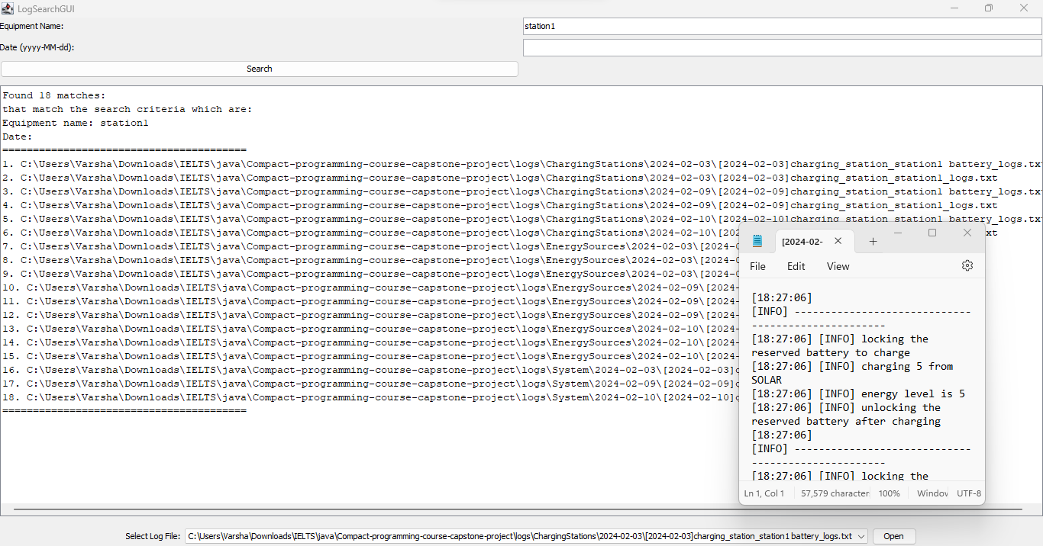
Running the Application
Execute Main.java to start the application
Two UIs will open:
Simulation of charging car
Provides real-time visualization of car charging process
Displays charging stations, cars, and queue status
Search utility for logs
Enables users to search for specific log entries

Slide 5
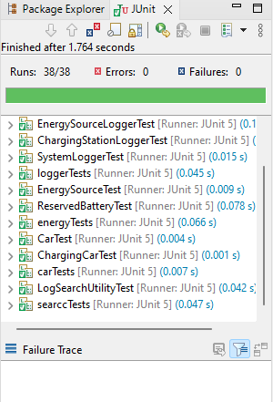
Tests
A total of 40 tests ensure robustness and reliability
Divided into 4 test suites, each corresponding to a package
Can be executed collectively or individually for targeted testing
Notes:
Tests
the application has 40 tests in total, divided into 4 test suites (one for each package).
they can be run all at once,
or a single feature can be tested by running the test suite for that feature.
or a single test can be run by running the test class for that test.

Slide 6
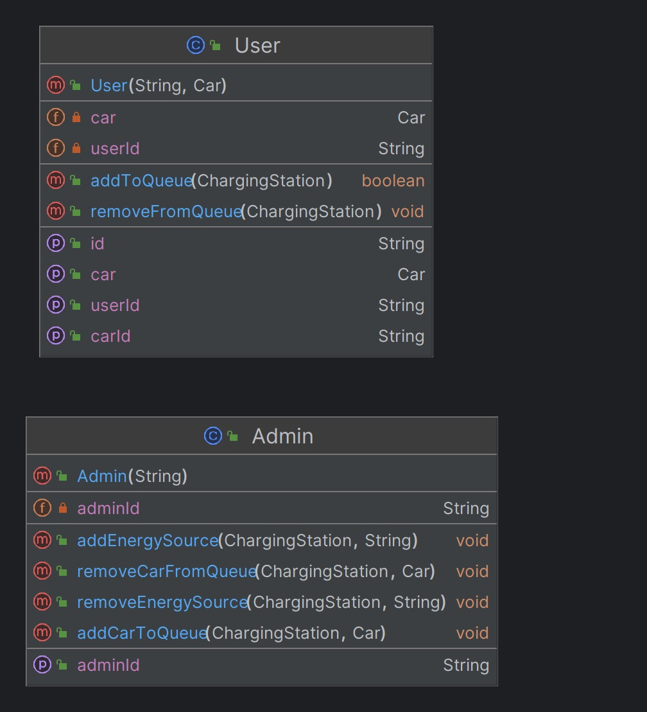
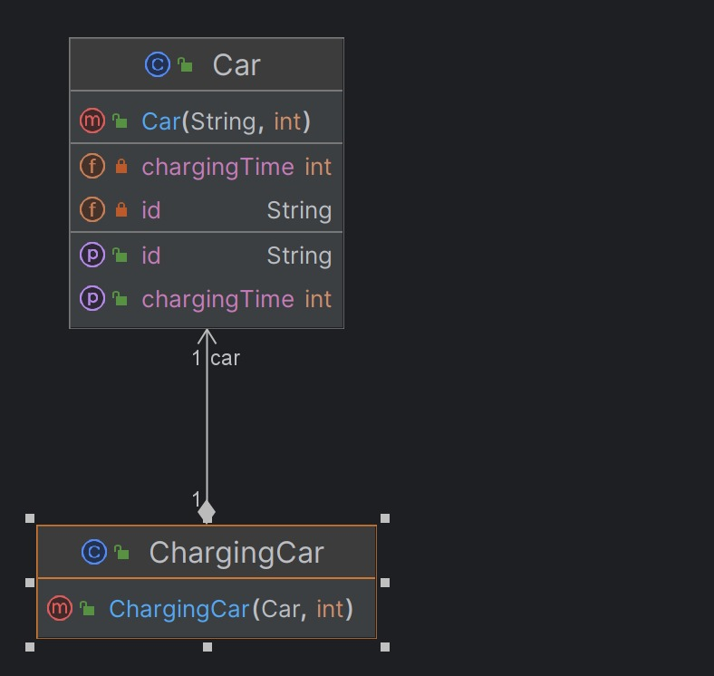
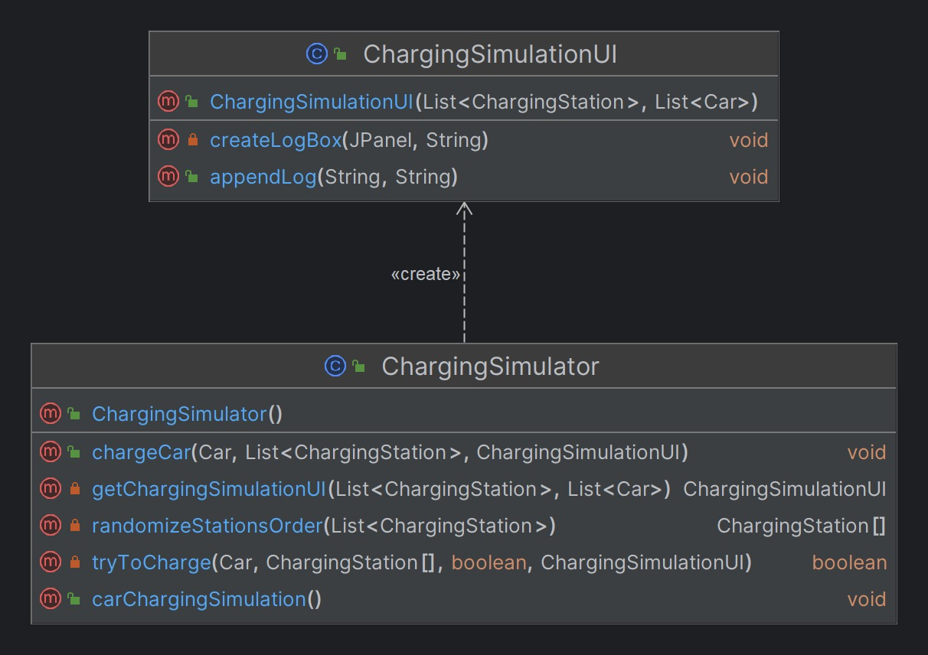
Class Diagrams

Slide 7
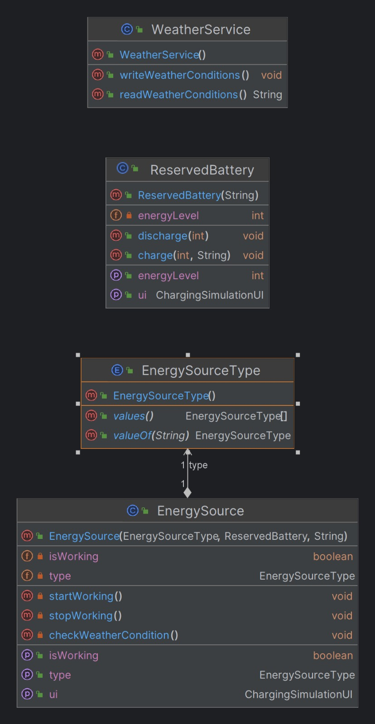
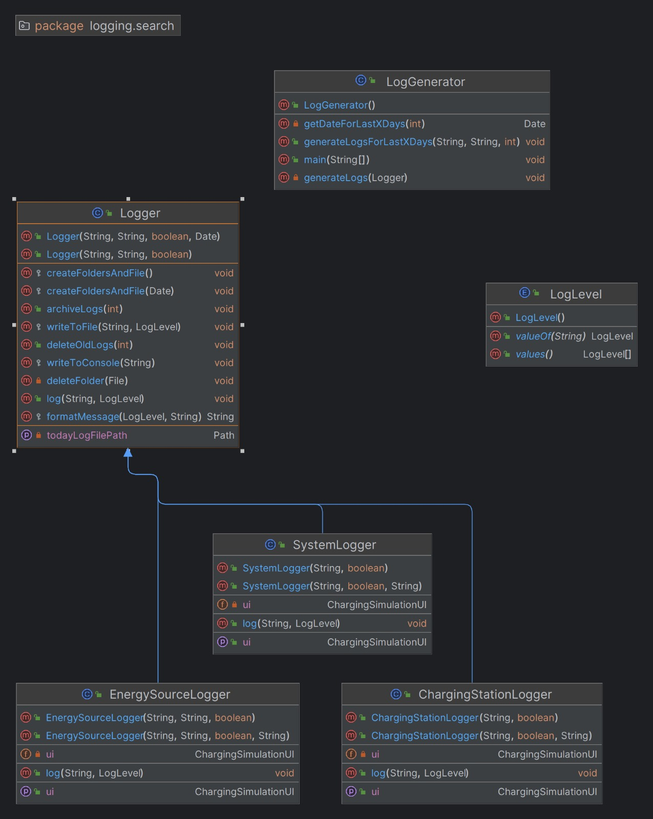
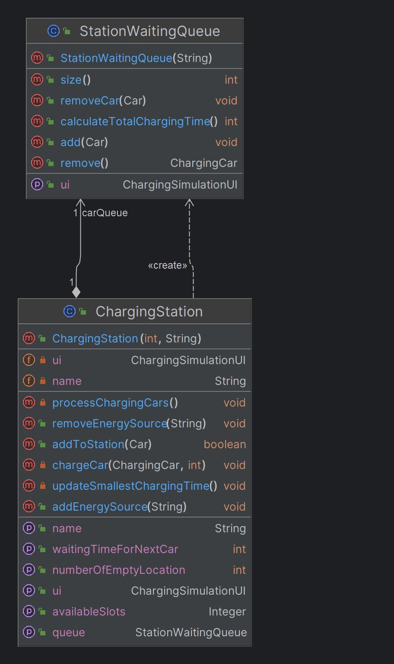
Class Diagrams

Slide 8
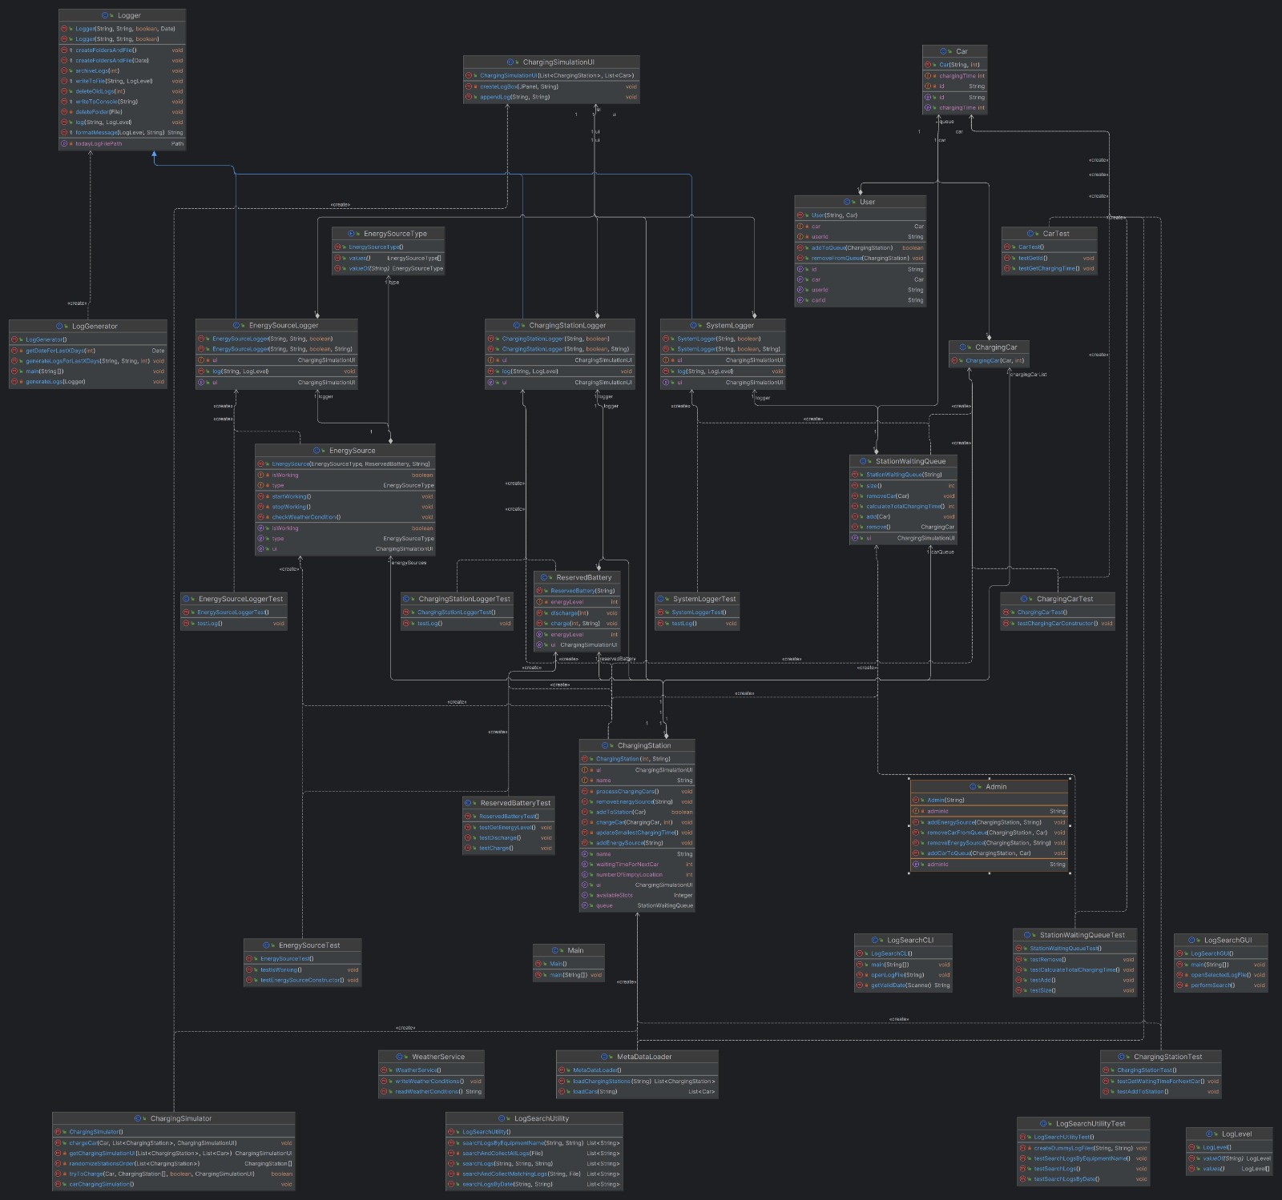
Class Diagrams

Slide 9
ChargingStation and Cars
ChargingStation:
Represents a physical charging station
Properties include station ID, charging slots, and energy sources
Cars:
Represents individual vehicles
Properties include car ID and charging speed
Notes:
ChargingStation and Cars
The ChargingStation and Cars are two fundamental entities in the car charging simulation. Here's a brief overview of each:
ChargingStation: Each ChargingStation object represents a charging station in the simulation. It has properties such as station's ID, charging slots, and a list of EnergySource objects.
The ChargingStation class has methods to add or remove energy sources, add a car to the station, and process charging cars.
It also has a StationWaitingQueue object to manage the queue of cars waiting to enter the station.
Cars: The Car class represents a car in the simulation. Each car has properties such as the car's ID, and charging speed. The Car class has methods to get the charging time and to check if the car is fully charged.
These classes interact with each other and with other classes in the simulation to simulate the process of charging cars at charging stations

Slide 10
Car Charging Simulation Logic
Initialization:
Load metadata from CSV files
Start weather simulation service
UI Setup:
Configure and display charging simulation interface
Car Charging:
Simulate parallel charging process for each car
Station Processing:
Manage charging slots and queue in each station
Queue Management:
Handle waiting queue for stations
Notes:
Car Charging Simulation Logic
The car charging simulation logic is implemented in the ChargingSimulator class and it works as follows:
Initialization: The simulation starts by loading the metadata for the charging stations and cars from CSV files. It also starts a weather simulation service that runs every 15 seconds.
UI Setup: A ChargingSimulationUI instance is created and set up with the charging stations and cars. The number of available slots in each station and the charging time for each car are logged to the UI.
Car Charging: For each car, the chargeCar method is called. This method creates a new thread for each car to simulate parallel charging.
Charging Attempt: Inside the chargeCar method, the car attempts to charge at each station in a randomized order. If the station is full, the car tries the next one after waiting for 1 second. If all stations are full, the car waits for 5 seconds and tries again. This process continues until the car is successfully charged.
Station Processing: Each ChargingStation object has a processChargingCars method that runs every second. This method checks each charging slot in the station. If a car is charging, it decreases the charging time. If the charging time reaches 0, the car leaves the station and the next car in the queue enters the station. If a slot is empty, the next car in the queue enters the station.
Queue Management: The StationWaitingQueue class manages the queue of cars waiting to enter a station. When a car is added to the queue, its charging time is logged. When a car is removed from the queue, it is ready to be charged. The queue also calculates the total charging time for all cars in the queue.

Slide 11
Car Queueing and Station Entry Logic
Attempt to Charge:
Randomized order to ensure fairness
Station Full:
Wait for available slot or switch to next station
All Stations Full:
Wait and retry until successful charge
Waiting Time:
Ensure reasonable waiting times for cars
Queue Entry:
Add cars to queue when no immediate slots available
Notes:
Car Queueing and Station Entry Logic
The decision for a car to enter the queue or station is made in the ChargingSimulator class, specifically in the chargeCar method. Here's how it works:
Attempt to Charge: The car attempts to charge at each station in a randomized order. This randomization is done to ensure fairness and prevent any station from being consistently overloaded.
Station Full: If a station is full (i.e., all charging slots are occupied & waiting time in the queue is larger than 15 minutes), the car tries the next station after waiting for 1 second. This wait time is implemented to simulate the real-world scenario where a car would need to travel to the next station.
All Stations Full: If all stations are full, the car waits for 5 seconds and tries again. This process continues until the car is successfully charged or the car decides to leave due to long waiting times.
Waiting Time: The waiting time for a car to enter a station is calculated in the ChargingStation class, specifically in the getWaitingTimeForNextCar method. If the waiting time is more than 15 minutes, the car will not enter the queue or the station and will switch to the next station. This is done to prevent cars from waiting too long to get charged.
Queue Entry: If a station has no available slots but the waiting time is less than 15 minutes, the car is added to the station's queue. The car will enter the station once a slot becomes available.
This logic ensures that cars are distributed evenly across stations and that no car waits too long to get charged.

Slide 12

Multi-User Access
Admin:
Manages energy sources and queue
User:
Adds/removes his/her car from queue
This Provides realistic simulation of user interactions
Notes:
Multi-User Access
In the car charging simulation, there are two types of users: Admin and User. Both of these users have the ability to interact with the ChargingStation and its StationWaitingQueue.
Admin: The Admin class represents an administrator who has the ability to add or remove energy sources from a charging station. They can also add or remove cars from a station's waiting queue. This is done through the addEnergySource, removeEnergySource, addCarToQueue, and removeCarFromQueue methods.
User: The User class represents a regular user who owns a car. They can add their car to a charging station's queue or remove it. This is done through the addToQueue and removeFromQueue methods.
This multi-user access allows for a realistic simulation of a car charging station, where different users have different levels of access and control.

Slide 13

Metadata Loading
Charging Stations Metadata:
Loaded from CSV files
Cars Metadata:
Also loaded from CSV files
Metadata Loading Process:
Initializes simulation with required entities
Notes:
Metadata Loading
In the car charging simulation, metadata is crucial for initializing the simulation. This metadata includes information about the charging stations and cars, and it is loaded from CSV files at the start of the simulation. Here's how it works:
Charging Stations Metadata: The ChargingStation class has a loadFromCSV method that reads a CSV file containing information about the charging stations. Each row in the CSV file represents a charging station and includes information such as the station's ID, location, number of charging slots, and energy sources.
Cars Metadata: The Car class also has a loadFromCSV method that reads a CSV file containing information about the cars. Each row in the CSV file represents a car and includes information such as the car's ID, model, battery capacity, and charging speed.
Metadata Loading: The ChargingSimulator class calls these loadFromCSV methods during its initialization. It creates a list of ChargingStation and Car objects based on the loaded metadata. These objects are then used throughout the simulation.
This metadata loading process allows the simulation to be easily configured and customized based on the provided CSV files.

Slide 14
Communication Inside the App
WeatherService:
Simulates weather conditions affecting energy production
ChargingStation:
Updates energy sources based on weather data
File-based Communication:
Facilitates indirect interaction between classes
Notes:
Communication Inside the App
In the car charging simulation, the WeatherService and ChargingStation classes communicate indirectly through a shared file. Here's how it works:
WeatherService: The WeatherService class simulates weather conditions that affect the energy production of the charging stations. Every 15 seconds, it generates new weather data and writes this data to a file. The weather data includes information such as sunlight intensity and wind speed, which affect the energy production of solar panels and wind turbines, respectively.
ChargingStation: Each ChargingStation has a list of EnergySource objects, which can be solar panels, wind turbines, or other types of energy sources. The ChargingStation class reads the weather data from the file every 15 seconds and updates its EnergySource objects accordingly. For example, if the sunlight intensity is high, the energy production of solar panels increases. If the wind speed is low, the energy production of wind turbines decreases.
This file-based communication allows the WeatherService and ChargingStation classes to interact and update the energy production based on the simulated weather conditions.

Slide 15
Logging System
Logger:
Base class for logging functionality
ChargingStation, EnergySource, and Systems:
Specialized loggers for specific components
Daily Log Writing:
Organizes logs by date for easy retrieval
LogGenerator:
Generates test logs for X amount of days
Useful for testing scenarios that run for multiple days
Notes:
Logging System
The logging system in the car charging simulation is implemented using several classes. Here's a brief overview of each:
Logger: The Logger class is the base class for all loggers in the system. It provides methods to log messages with different log levels (INFO, WARNING, ERROR), write logs to a file, and write logs to the console. It also provides methods to archive and delete old logs.
ChargingStationLogger: The ChargingStationLogger class extends the Logger class. It is used to log messages related to a specific charging station. It also has a reference to the ChargingSimulationUI to update the UI with log messages.
EnergySourceLogger: The EnergySourceLogger class extends the Logger class. It is used to log messages related to a specific energy source in a specific charging station. It also has a reference to the ChargingSimulationUI to update the UI with log messages.
SystemLogger: The SystemLogger class extends the Logger class. It is used to log system-wide messages. It also has a reference to the ChargingSimulationUI to update the UI with log messages.
LogGenerator: The LogGenerator class is used to generate test logs for the last x days. It uses the Logger class to create logs.
These classes work together to provide a comprehensive logging system for the car charging simulation.
Daily Log Writing
In the car charging simulation, logs are written on a daily basis. This is handled by the Logger class. Here's how it works:
Log File Creation: Each day, a new log file is created for each logger. The log file is named with the date of the logs and the name of the logger (e.g., [2023-03-15]charging_station_1_logs.txt). This is done in the createFoldersAndFile method of the Logger class.
Log Writing: Throughout the day, log messages are written to the day's log file. Each log message is timestamped with the time it was logged. This is done in the log method of the Logger class.
Log Archiving and Deletion: At the end of the day, the log file is archived and old logs are deleted. This is done in the archiveLogs and deleteOldLogs methods of the Logger class.
This daily log writing process ensures that logs are organized by date, making it easy to find and review logs for a specific day.

Slide 16

Search Functionality
LogSearchUtility:
Java class for searching logs by name/date
LogSearchCLI:
Command-line interface for log search
LogSearchGUI:
Graphical interface for log search
Implementation Details:
Utilizes File and Pattern classes for search
Notes:
Search Functionality
The search functionality in this application is primarily handled by the LogSearchUtility class, LogSearchCLI class, and LogSearchGUI class.
LogSearchUtility
The LogSearchUtility class provides methods to search for logs in the log folder based on name/date or any combination of the two. It is written in Java and is part of the search package.
Methods
The LogSearchUtility class provides the following public methods:
searchLogs(String equipmentName, String dateString, String baseFolderPath): This method searches for logs based on the equipment name and date. It returns a list of matching log file paths.
searchLogsByEquipmentName(String equipmentName, String baseFolderPath): This method searches for logs based on the equipment name. It returns a list of matching log file paths.
searchLogsByDate(String dateString, String baseFolderPath): This method searches for logs based on the date. It returns a list of matching log file paths.
LogSearchCLI
The LogSearchCLI class provides a command-line interface for the log search functionality. It prompts the user to enter the equipment name and date, and then it uses the LogSearchUtility to search for matching logs. The user can then choose a log file to open.
LogSearchGUI
The LogSearchGUI class provides a graphical user interface for the log search functionality. It has text fields for the user to enter the equipment name and date, and a button to perform the search. The search results are displayed in a text area and a combo box. The user can select a log file from the combo box and click a button to open it.

Slide 17
Thank you
1. Ahmed Hobeishy (7219053, MDT)
2. Varsha Vijayan (7216653 ,MDT)
3. Silpa Prasad Sivaprasad (7216655 ,MDT)

